Slide 2
Building a Pagelet for HealtheLife
Michael Hemesath & Nick Smith

Slide 3
Introduction
Notes:
Mike and Nick talk provide background introductions.

Slide 4
What is a Pagelet?

Slide 5
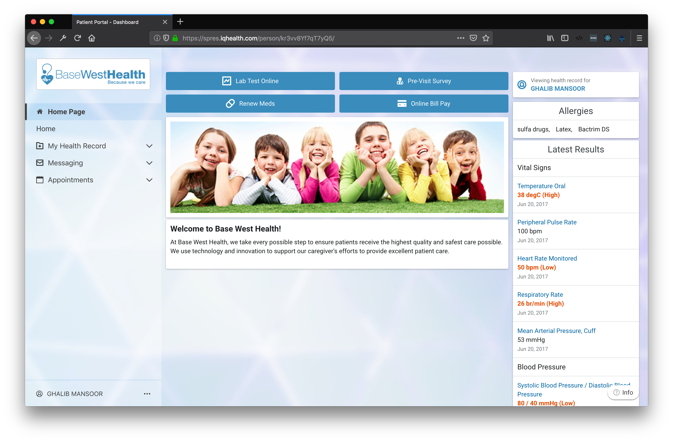
Notes:
Patient portal provides limited configuration/layout options.

Slide 6
What is a Pagelet?
A pagelet enables the ability to dynamically combine and embed disparate web applications together into HealtheLife.

Slide 7
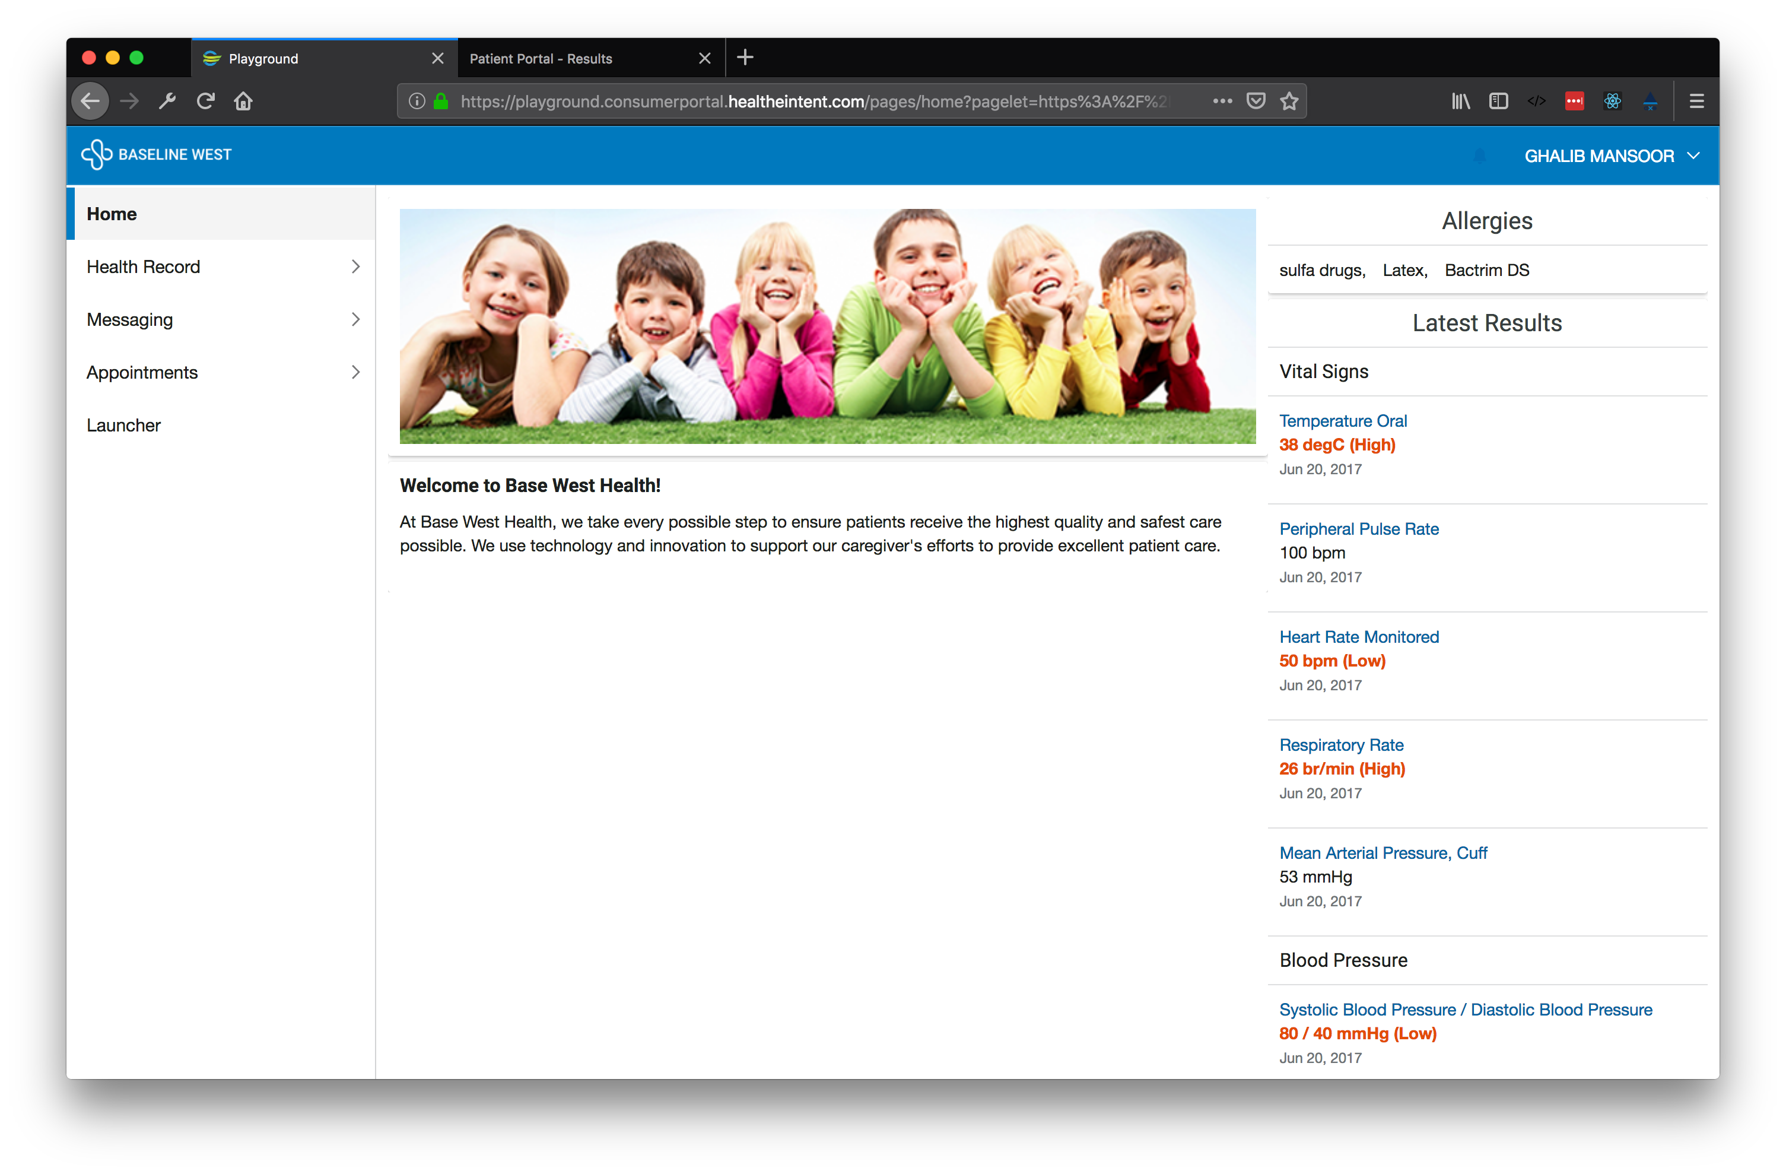

Slide 8
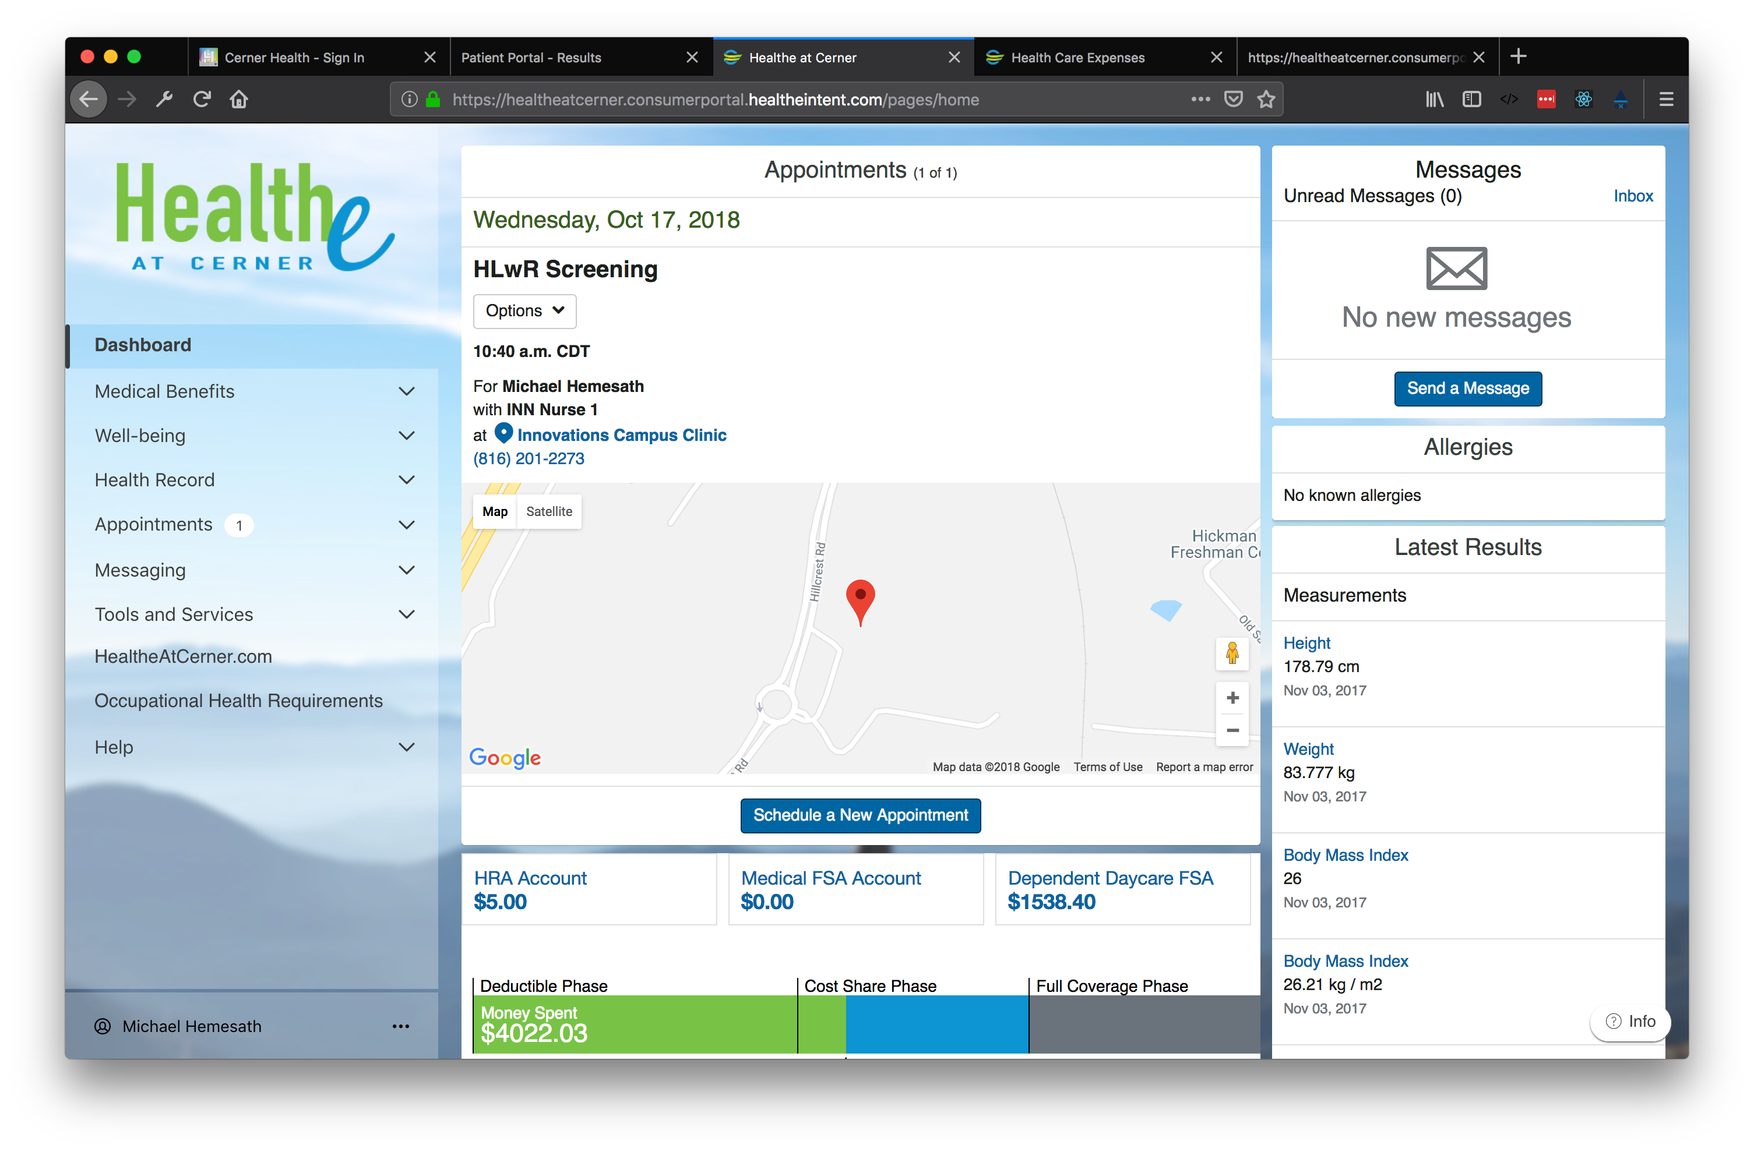

Slide 9
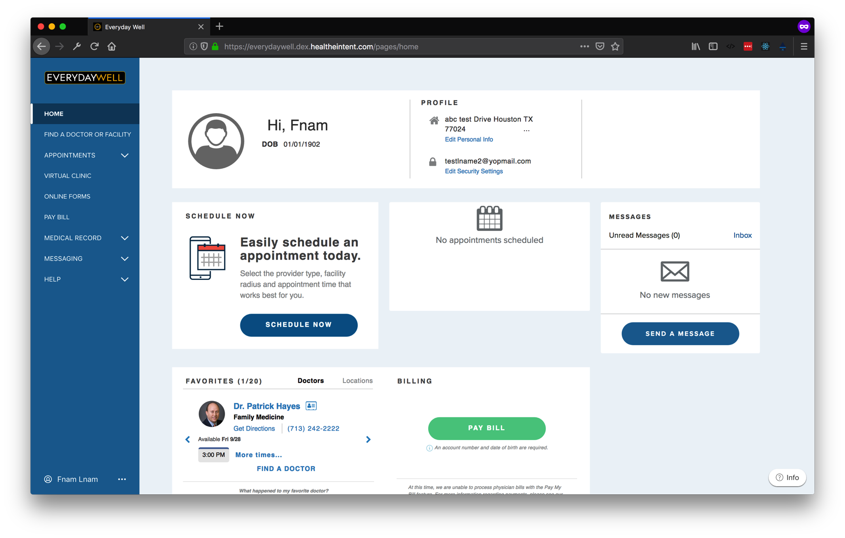
Notes:
Pagelets enable dynamic layouts and content

Slide 10
Notes:
Pagelets also enable the ability for content to be developed, deployed, hosted and embedded

Slide 11
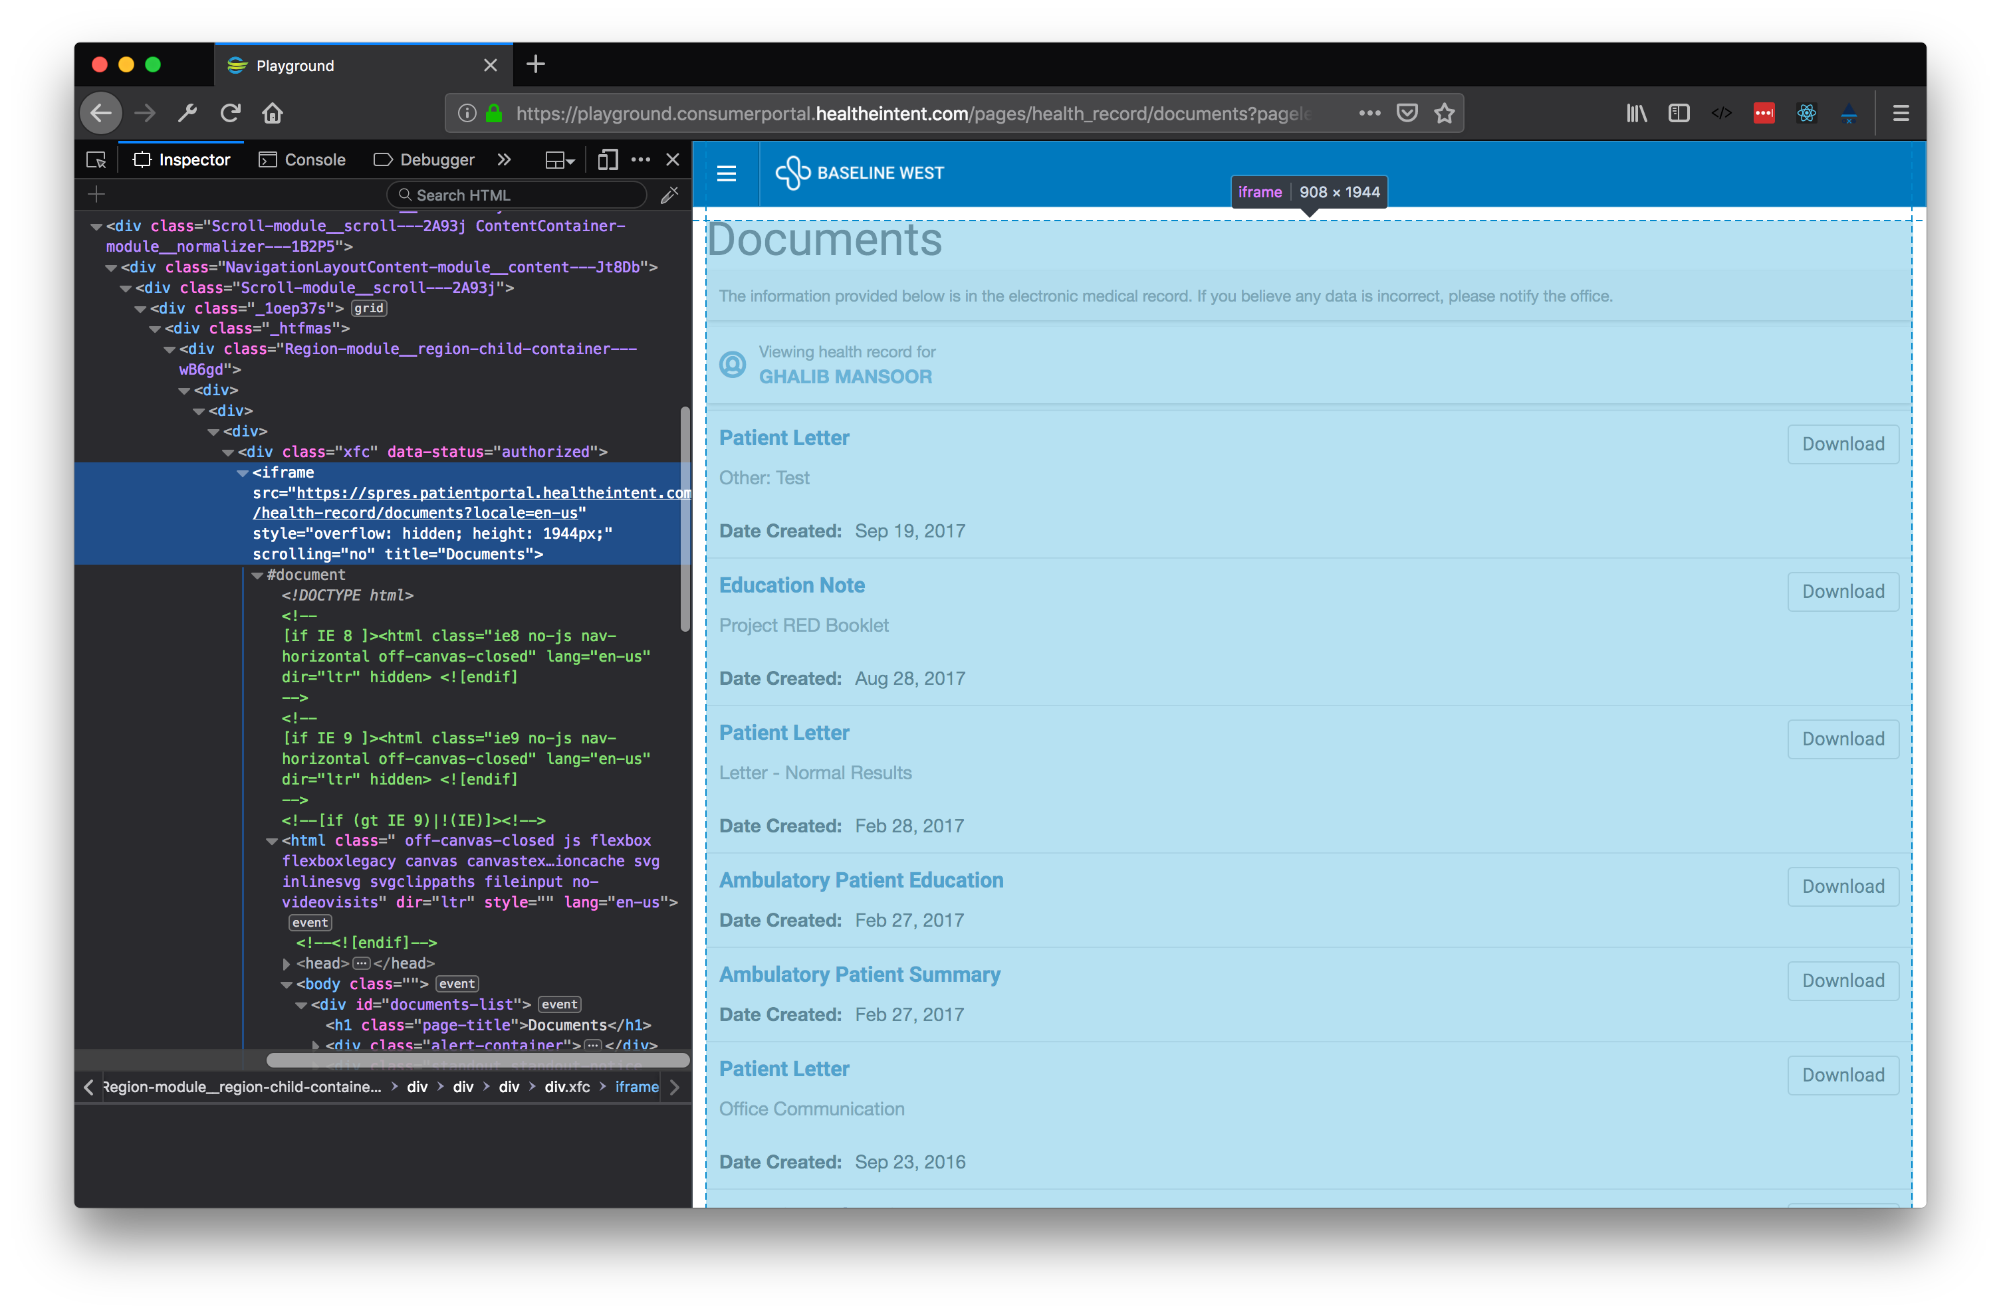
What is a Pagelet
A standalone web app loaded through an iFrame
Includes a SDK JavaScript file to communicate with HealtheLife

Slide 12
Why iFrames?
CSS and JavaScript Sandboxing
Styling won’t conflict across pagelets
Scripts dependencies won’t conflict across pagelets
Security
Same-Origin Policy
Distributed development
Each pagelet can be released independent of HealtheLife and each other
Implementation
Low cost to ”pageletize” existing apps
Notes:
- Pagelets are embedded apps or web sites
- URL declares where to load content

Slide 13
Notes:
Pagelets enable dynamic layouts and content

Slide 15
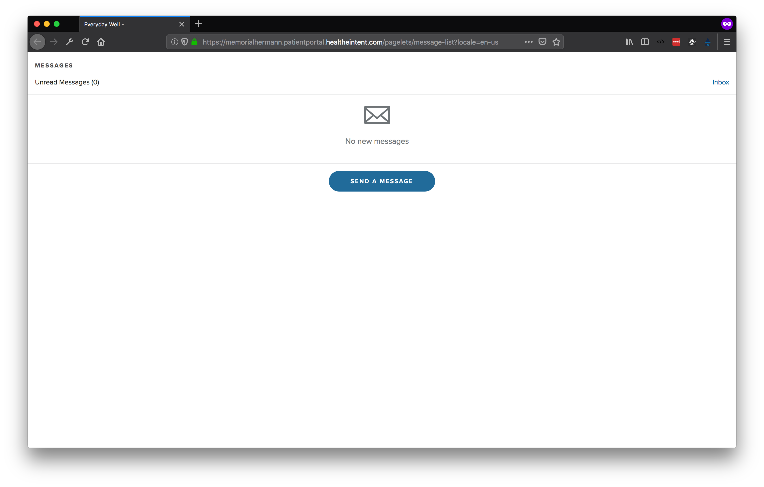
What is a pagelet

Slide 16
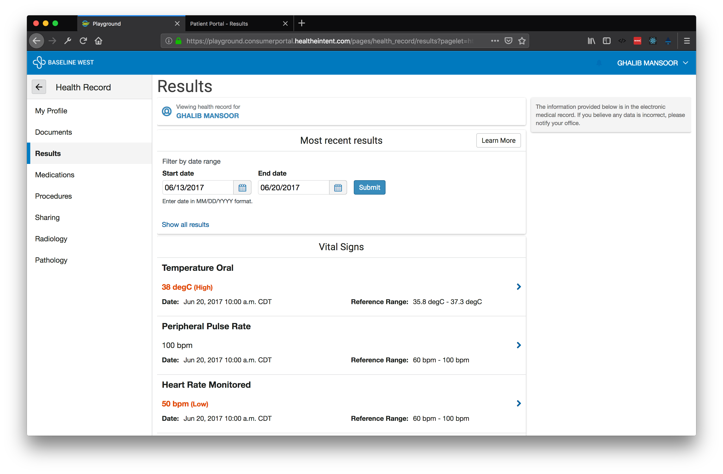
Pagelet Examples
Notes:
- Pages make up the content of the HealtheLife
- Pages arrange Pagelets onto the screen in a grid

Slide 17
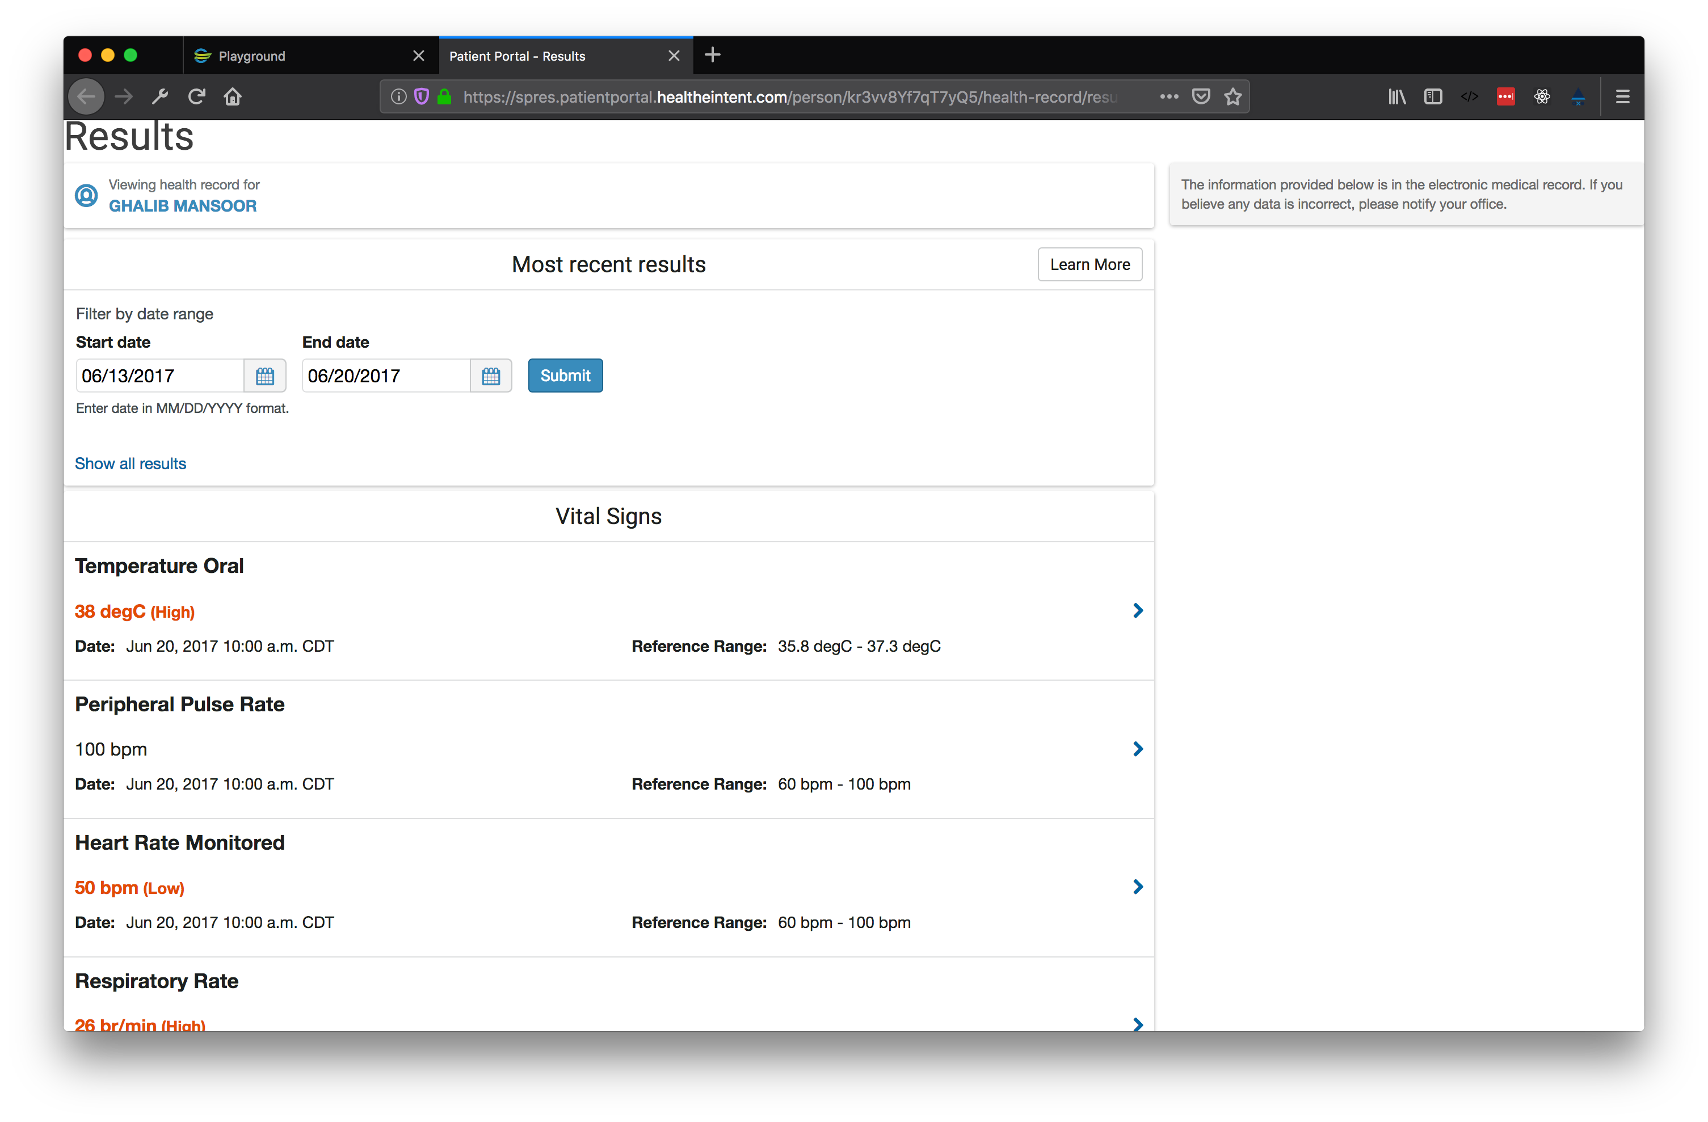
Pagelet Examples
Notes:
- Pages make up the content of the HealtheLife
- Pages arrange Pagelets onto the screen in a grid

Slide 18
Building a Pagelet

Slide 19
Building a Pagelet
Authentication
HTML
Response Headers

Slide 20
Building a Pagelet: Authentication
Pagelets use SAML (Security Assertion Markup Language) to exchange authentication information with the identity provider.
SAML is required for IDPs that integrate with HealtheLife
https://wiki.cerner.com/display/public/reference/HealtheLife+SAML+2.0+Specification
HealtheLife will authenticate with the identity provider and single-sign-on the user before the pagelet is loaded.
User ID provided by SAML response
HealtheIntent consumer can be accessed via public API
Patient identifier can be accessed from consumer

Slide 21
Building a Pagelet: Authentication
IMPORTANT
Pagelet developers takes responsibility for authenticating, authorizing and properly protecting personal health information and identifiers!

Slide 22
Building a Pagelet: HTML
Create HTML page for pagelet
Add CSS to HTML for pagelet loading and embedding
Include SDK into pagelet HTML
Initialize SDK on page load

Slide 23
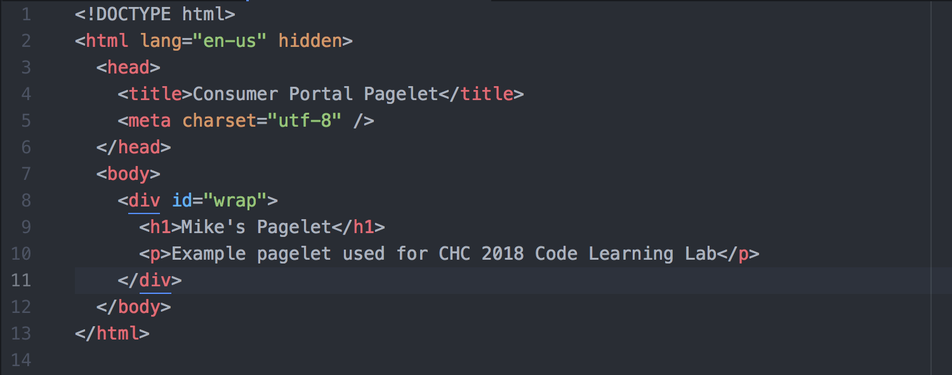
Building a Pagelet: HTML

Slide 24
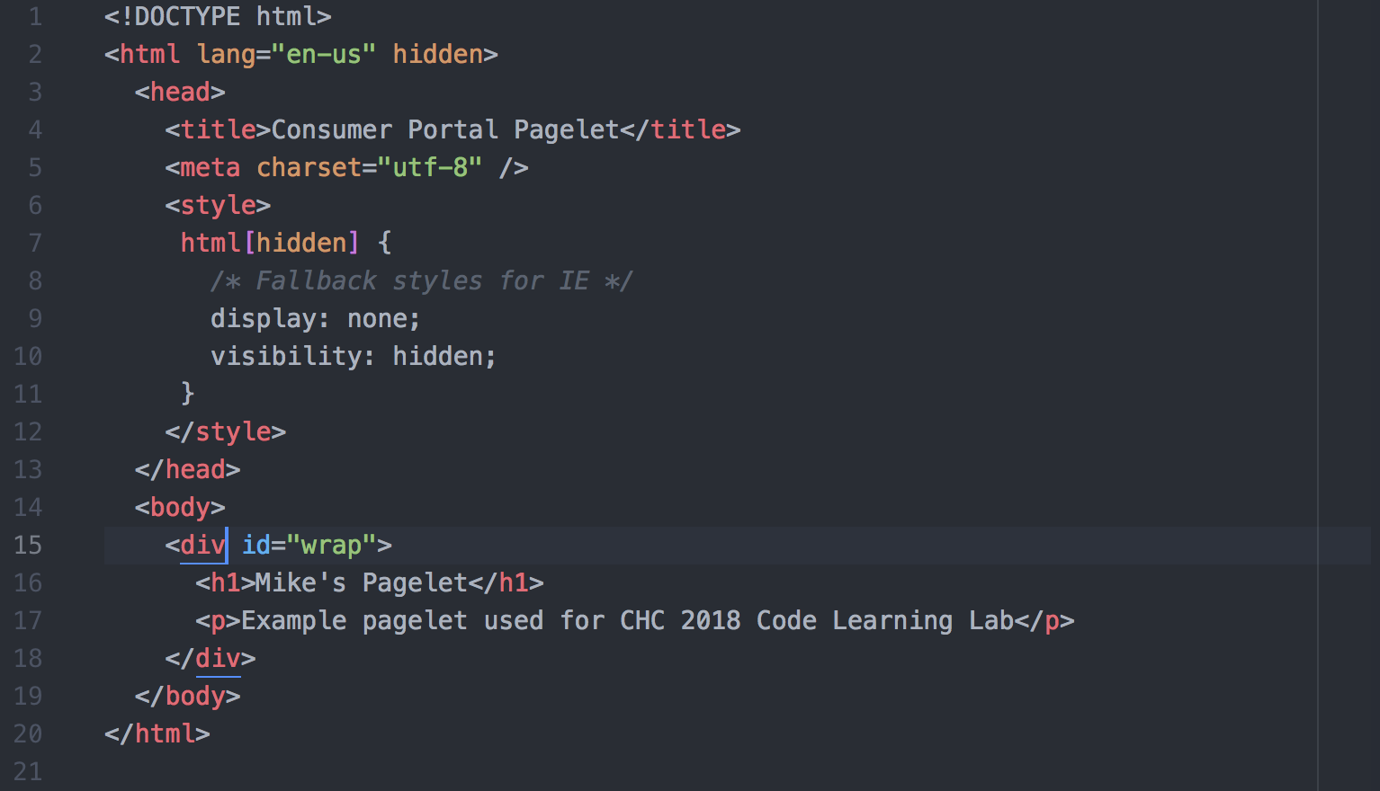
Building a Pagelet: CSS

Slide 25
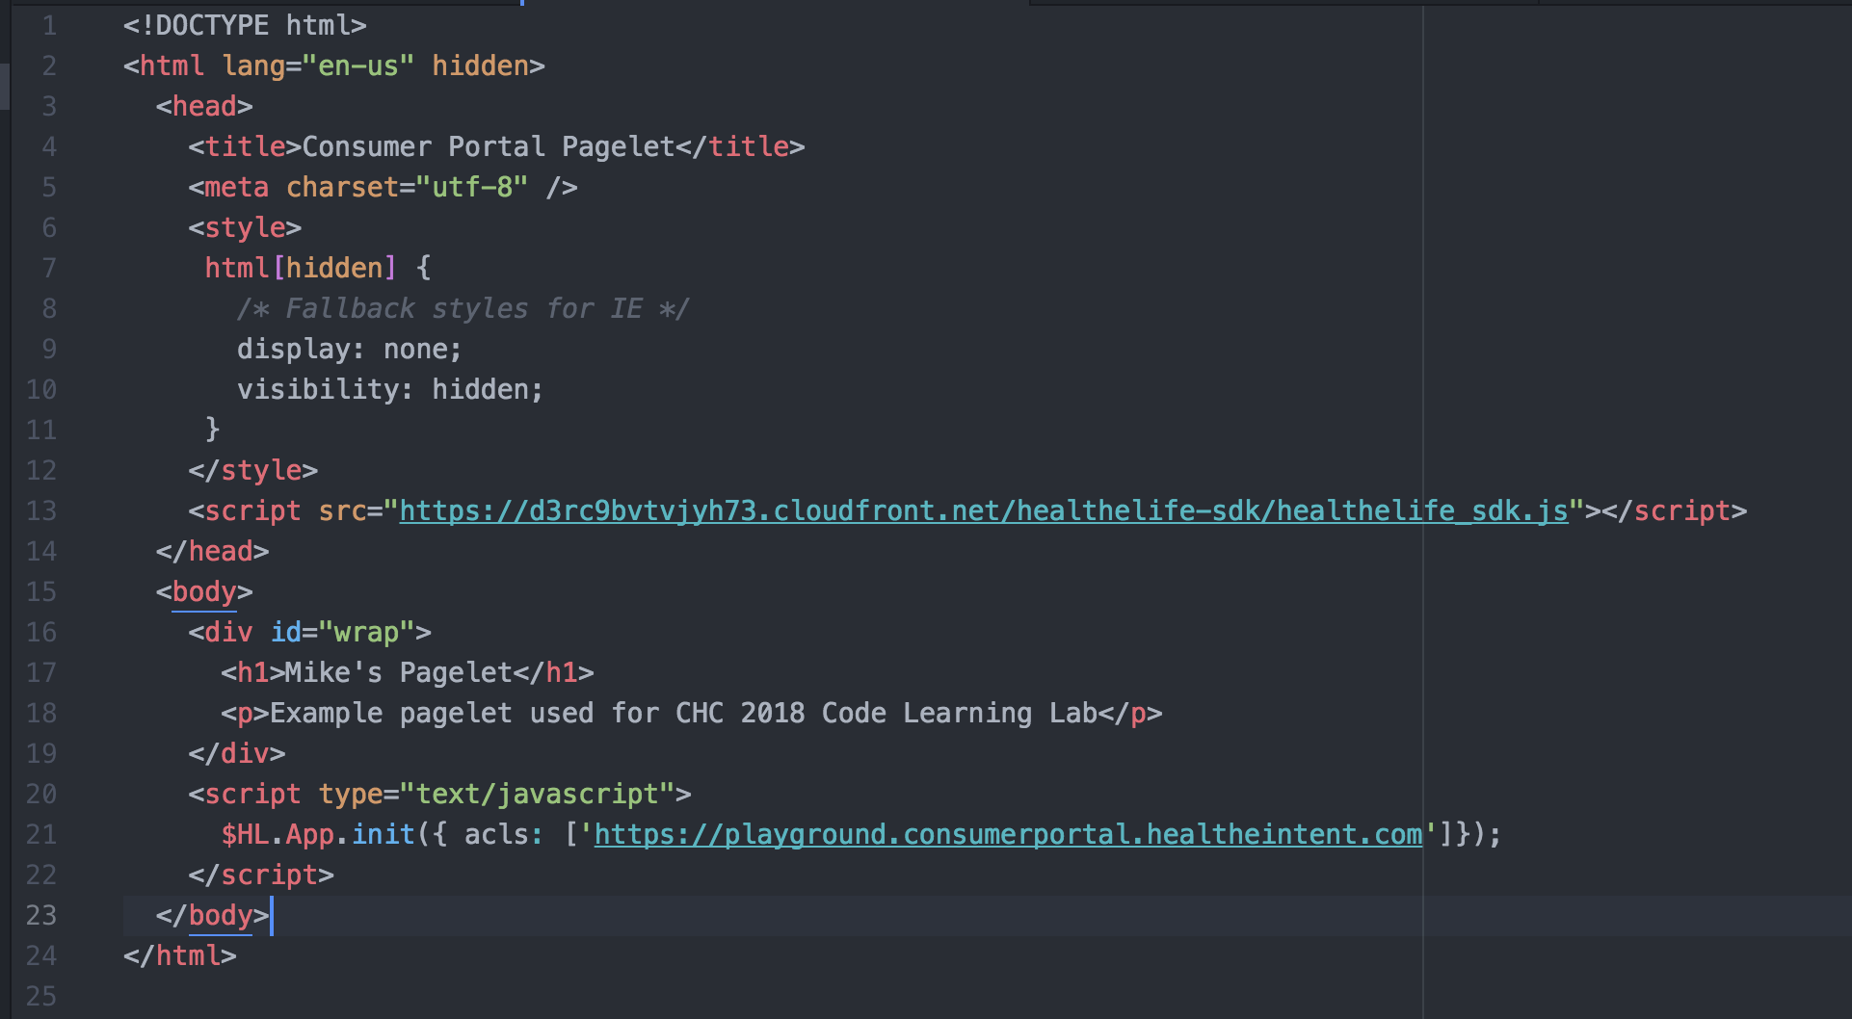
Building a Pagelet: JavaScript

Slide 26
Building a Pagelet: Response Headers
2 HTTP response headers should be used for pagelets.
p3p – Deprecated policy required by IE11 to indicate privacy policy of the 3rd party framed sites
Content-Security-Policy - Protects pagelets against clickjacking
Example
p3p: CP="NON CUR OTPi OUR NOR UNI"
Content-Security-Policy: frame-ancestors ' https://*.consumerportal.healtheintent.com ';

Slide 27
3rd Party Tracking Prevention
Safari and Firefox may block 3rd Party Cookies
Intelligent Tracking

Slide 28
SDK API

Slide 29
HealtheLife SDK
https://docs.healtheintent.com/api/alpha/healthelife/
Coordinates the loading, authorization and display of pagelets
Authorizes the pagelet is only embedded in a domain matching the configured ACL
Auto sizes iframe to match content height
Has methods for sending events from pagelet to HealtheLife and vice versa
Scroll pagelet into view

Slide 30
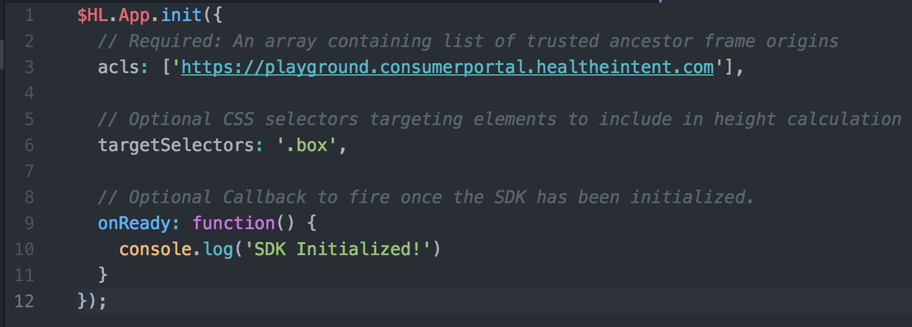
SDK API: $HL.App.init()

Slide 31
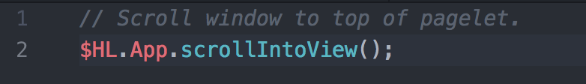
SDK API: $HL.App.scrollIntoView()
Scrolls window to top of pagelet
Useful for opening modals and notifications

Slide 32
Adding a Pagelet to HealtheLife

Slide 33
Adding a Pagelet to HealtheLife
Currently Configured by Cerner Associates

Slide 34
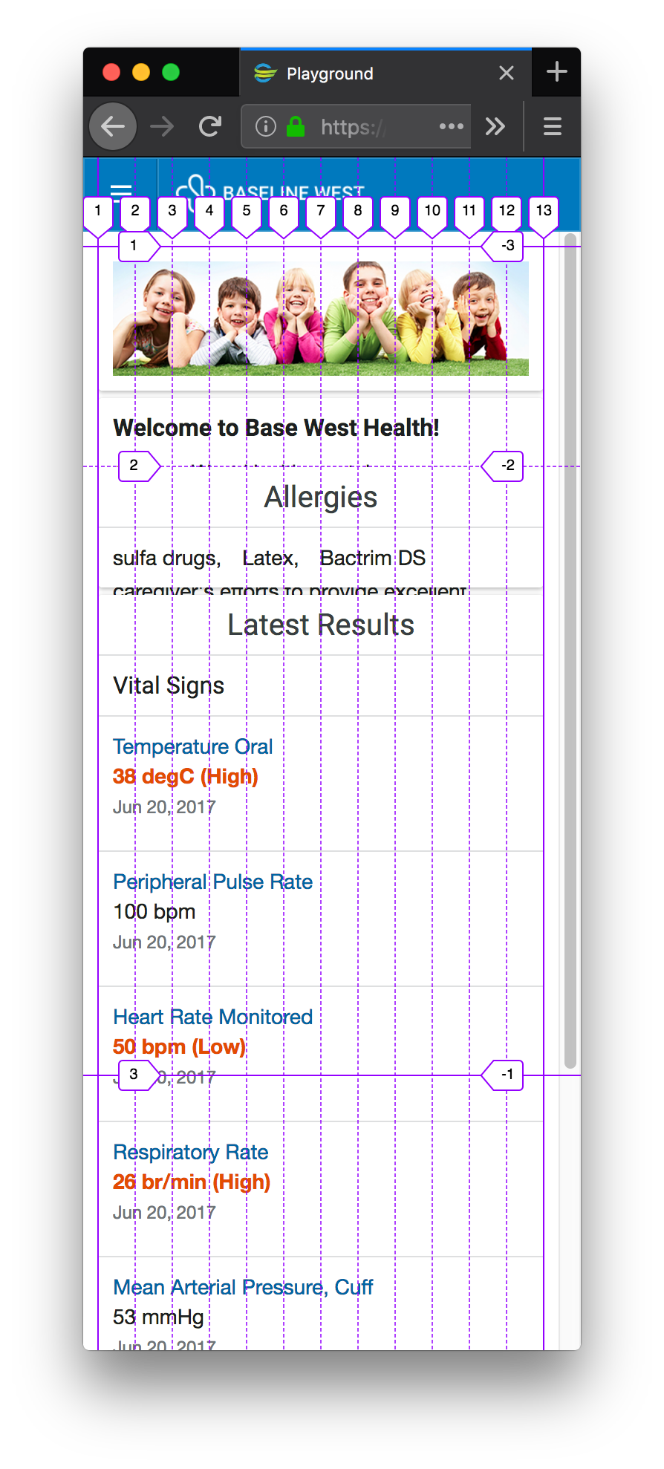
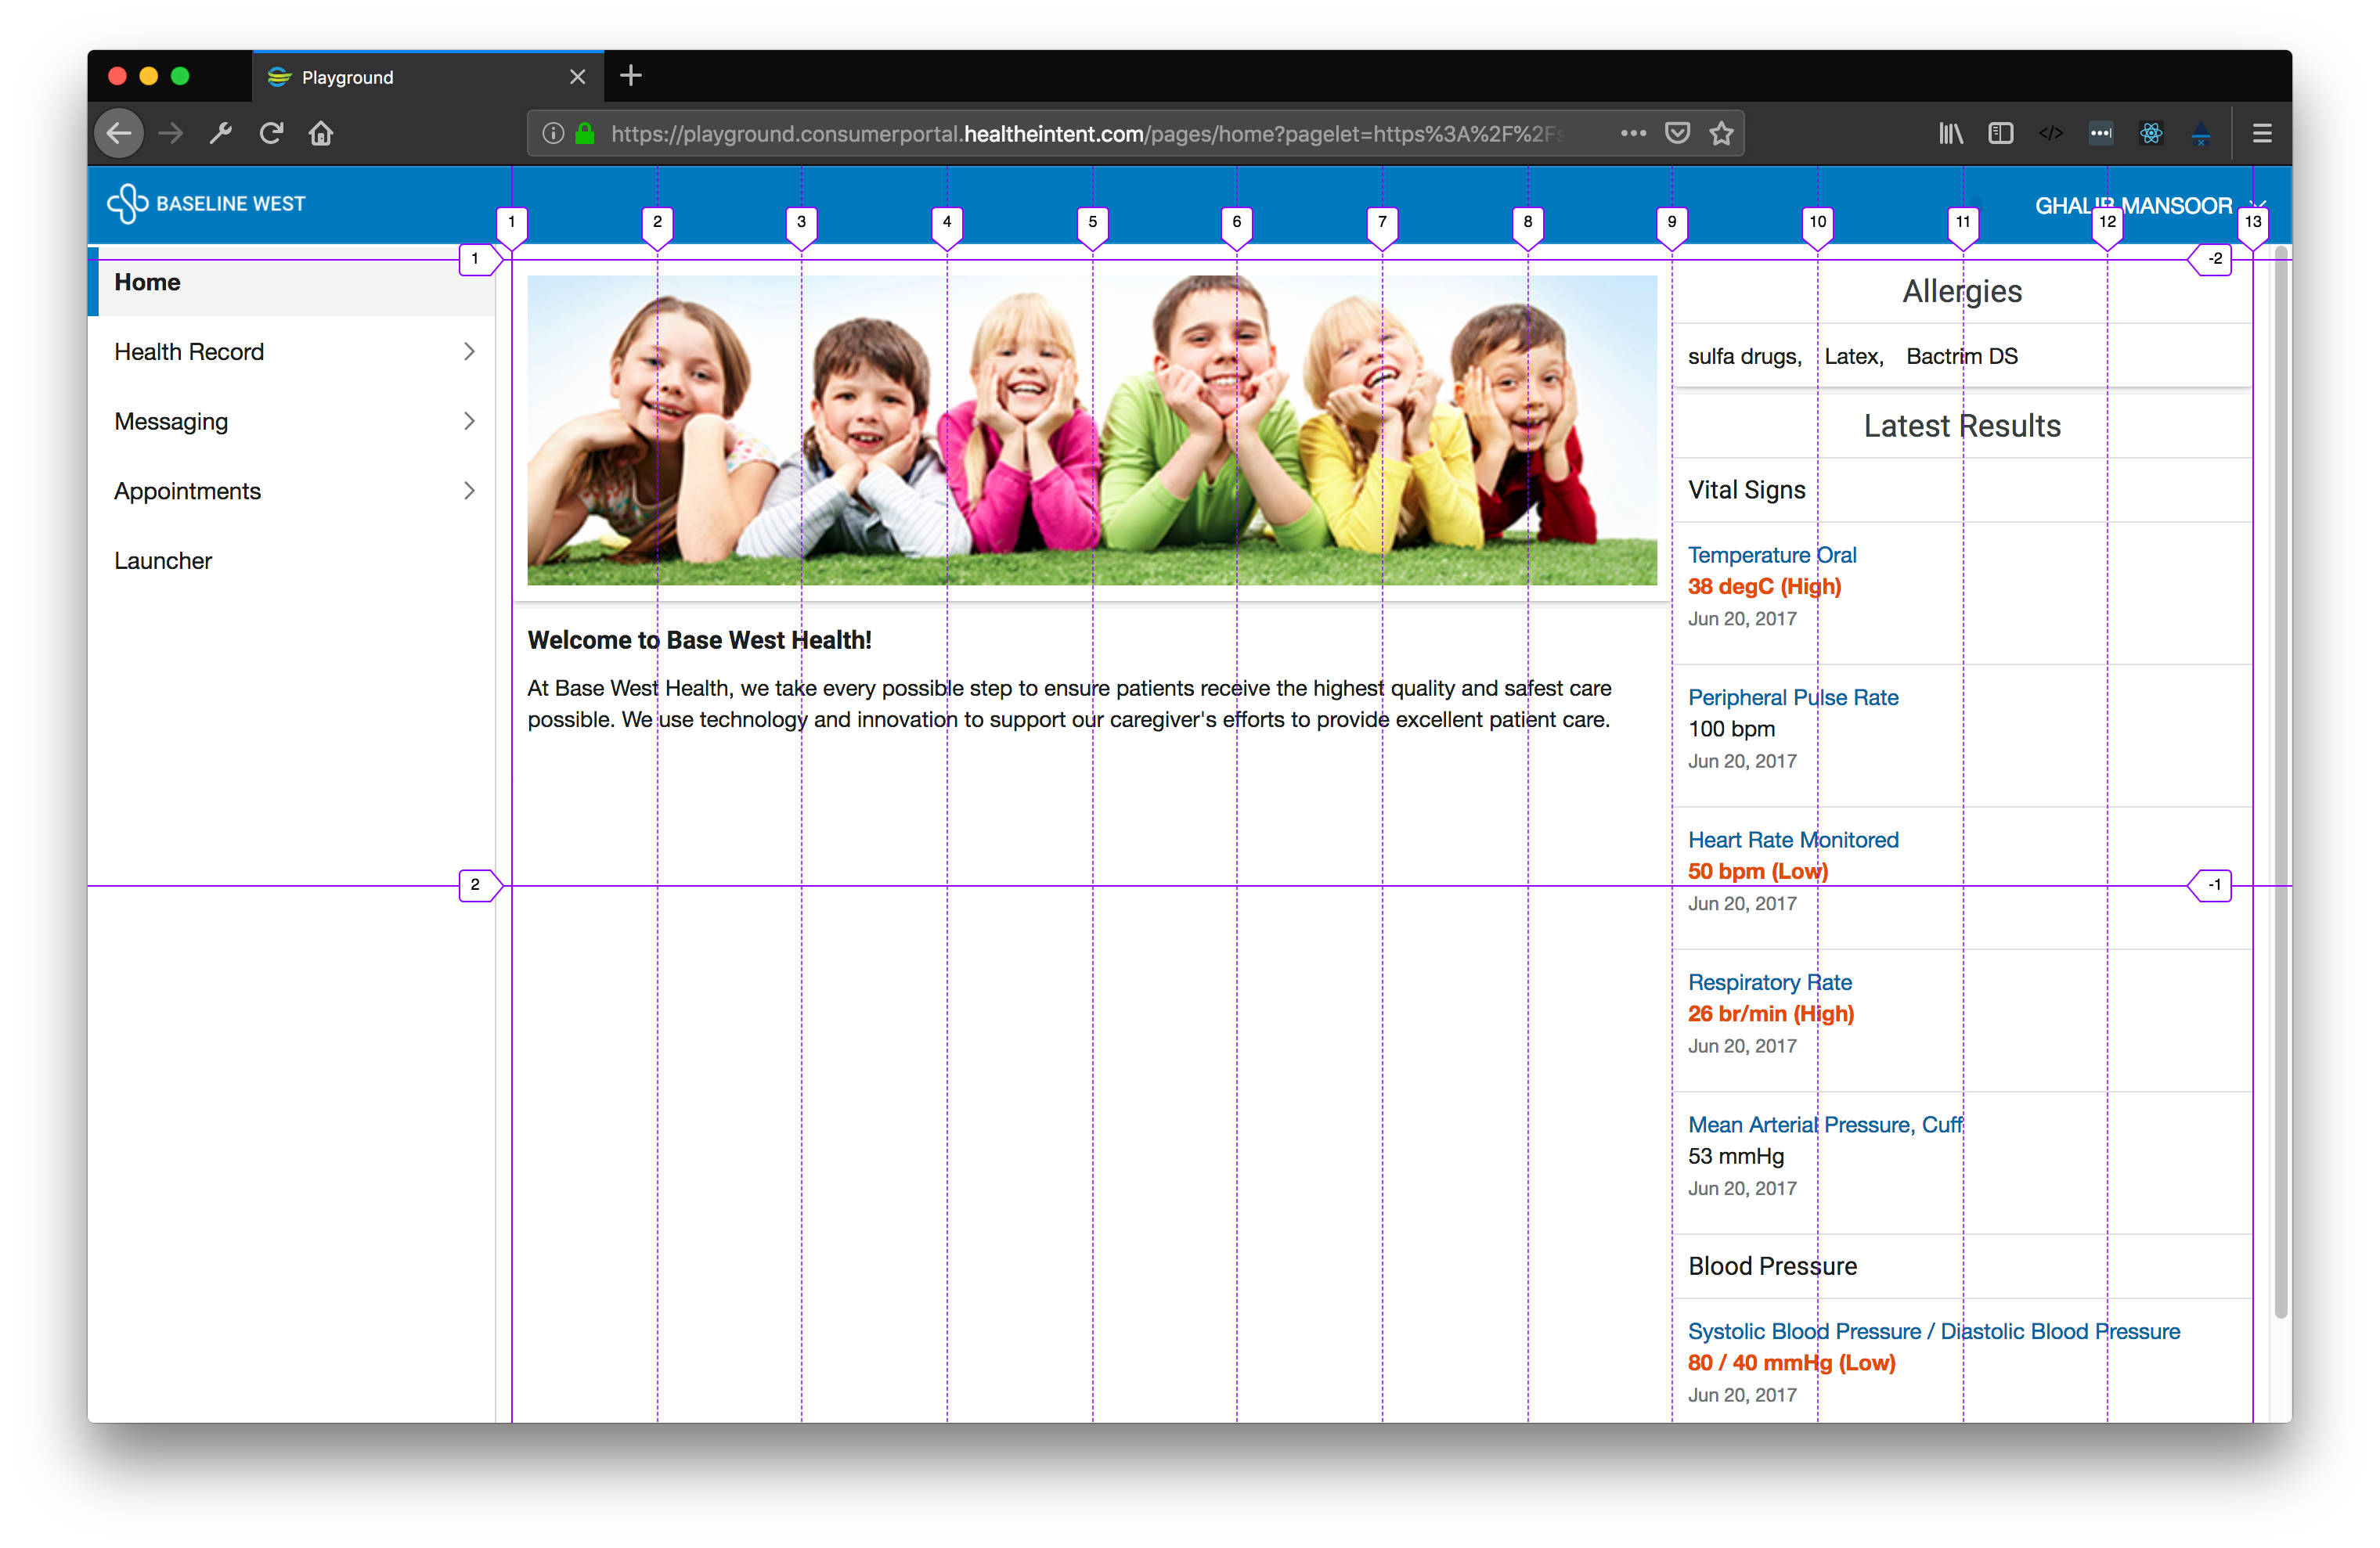

Slide 35
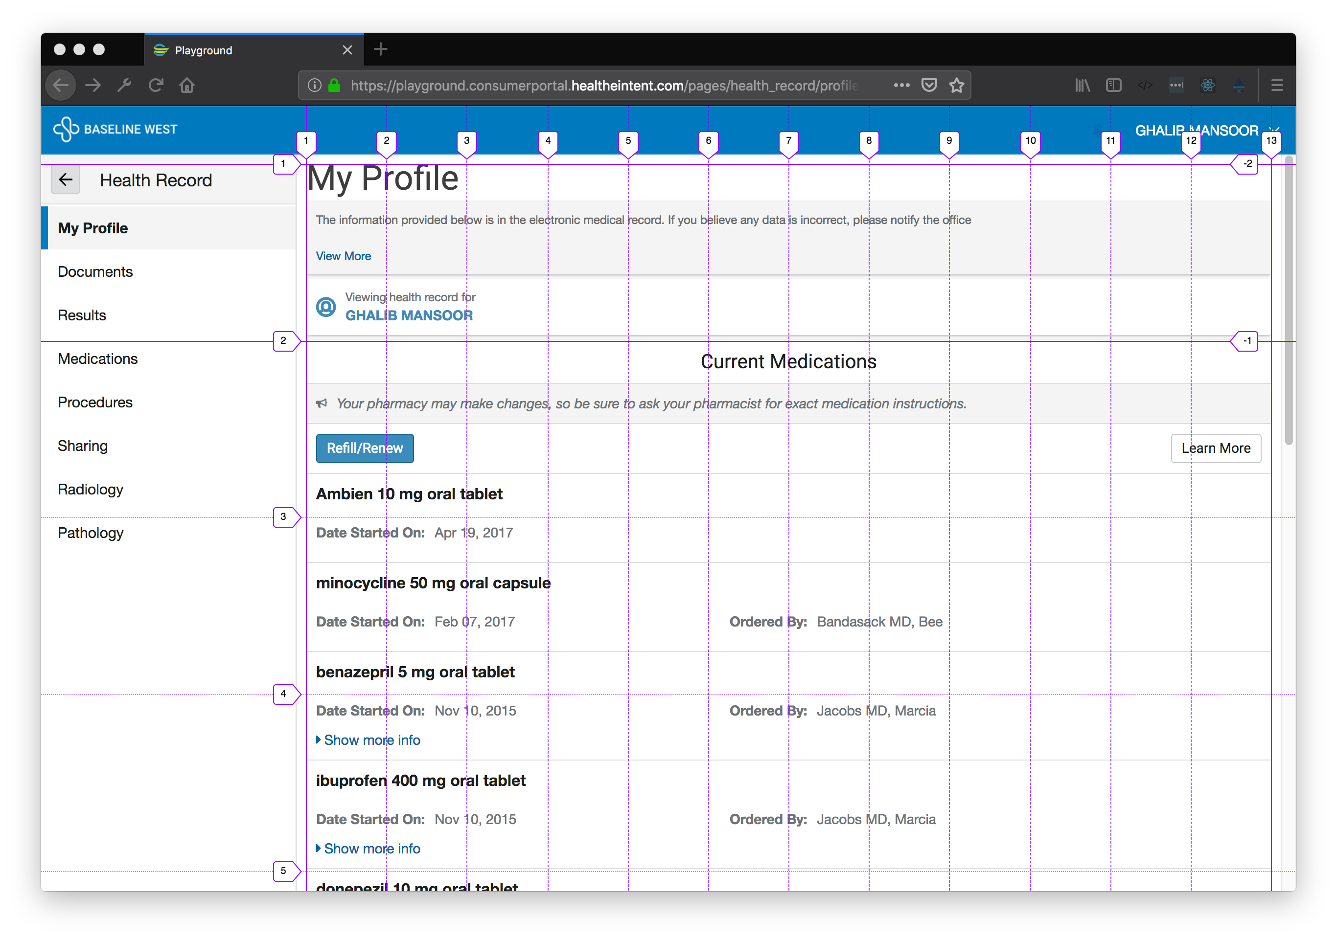

Slide 36
Walkthrough

Slide 37
Styling Considerations
Ensure hidden attribute set
Set ACL to trusted domain(s)
Don’t style to 100% or 100vh
Whitelist absolute/fixed elements with targetSelectors
Follow responsive, fluid design patterns
Use cards, not background styles

Slide 38
Questions?

Slide 39
Exercises

Slide 40
Exercises
https://docs.healtheintent.com/exercises/chc2018/#creating-a-pagelet-for-the-consumer-portal
Try pagelitizing an existing web app you have!
Mike.hemesath@cerner.com
Nick.smith@cerner.com

